Slide 1
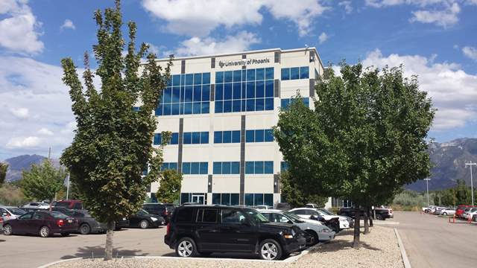
Data architecture project part iii
ELBIO ISEAS
DBM/384
Faculty : Devin Dickens
09/05/2016

Slide 2
introduction
The spatial PayRoll database uses four tables for the process of the model of the Online Transaction Processing (OLTP). This database uses the FactWorkedHours for storing the payroll information of worked hours and the geographical location of the employees for the worked hours in the company. The table DimEmployees stores the employee ID, names, and the latitude and longitude where each employee works. The DimSalaries stores the hour values depending on what each employee makes, and it keeps track of the dates that hour value changed. The fourth table: DimDepartments stores the different departments of the company .

Slide 3
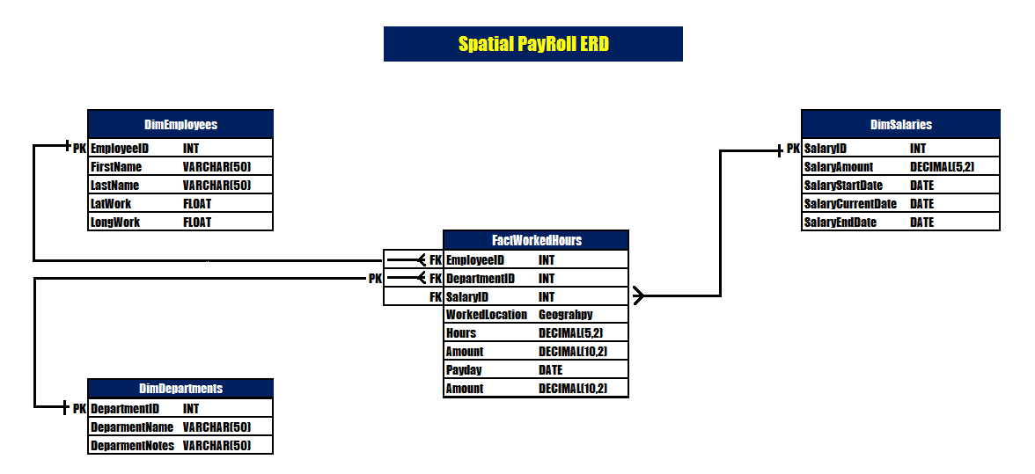
Spatial database Erd

Slide 4
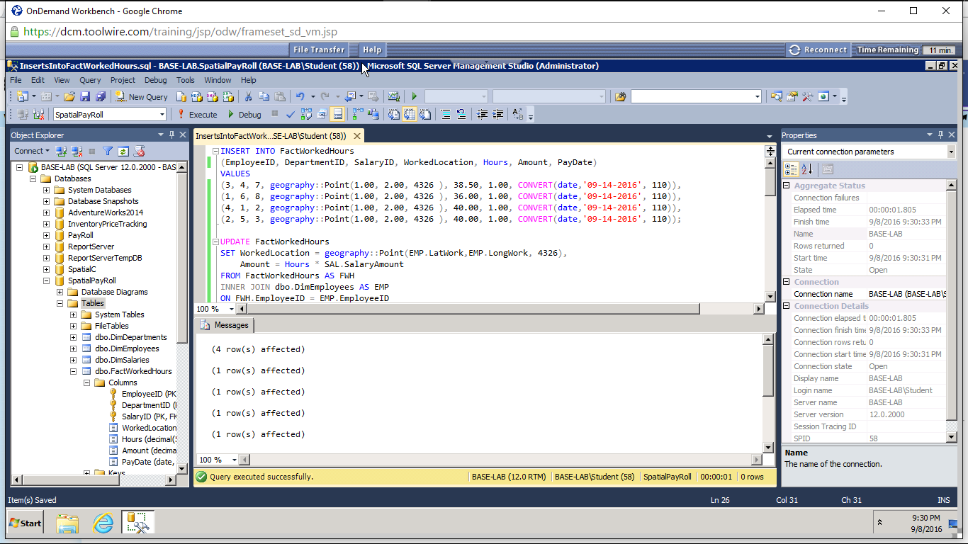
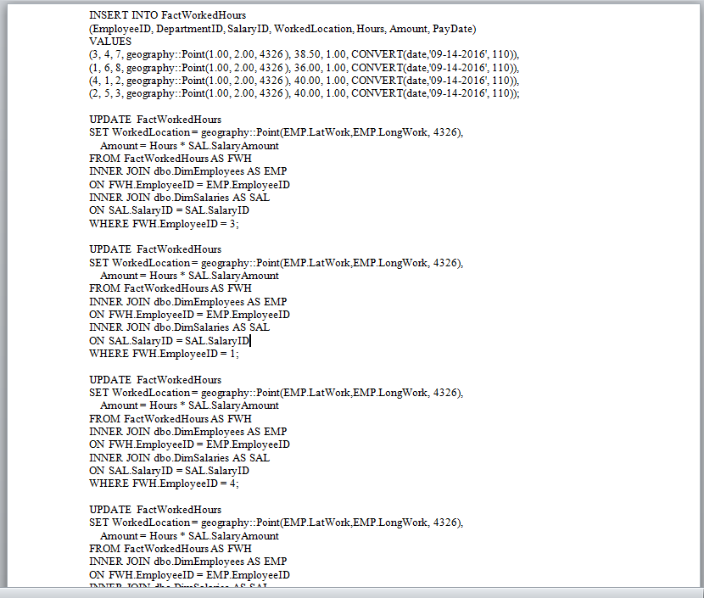
Sql server scripts

Slide 5
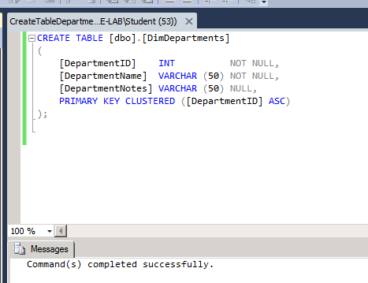
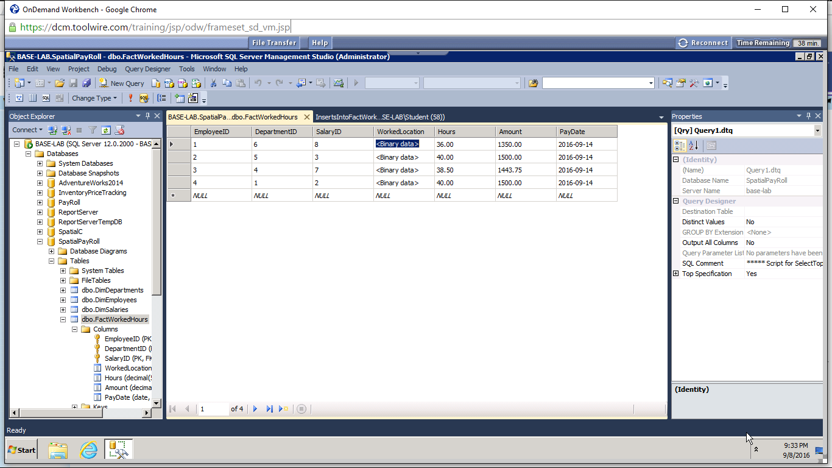
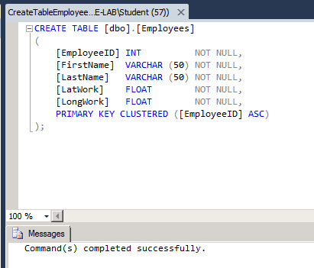
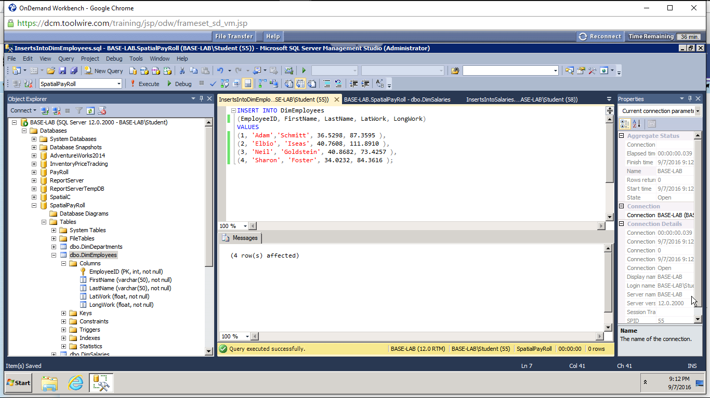
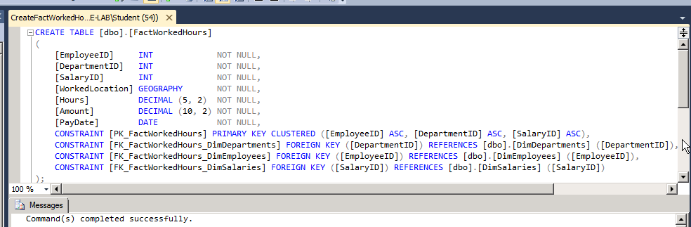
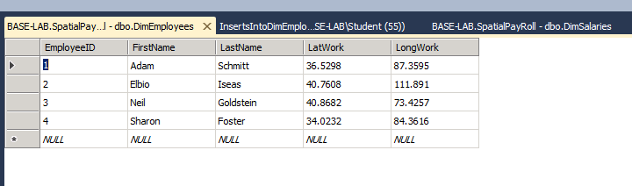
Sql server scripts continue

Slide 6
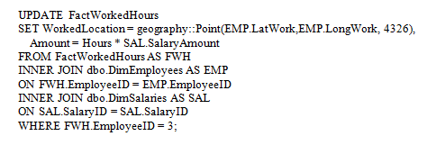
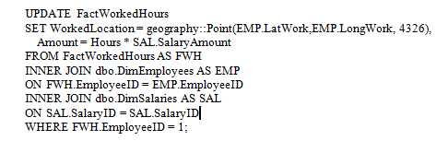
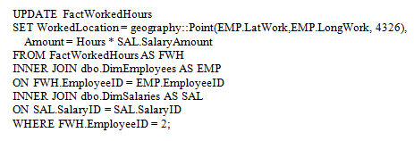
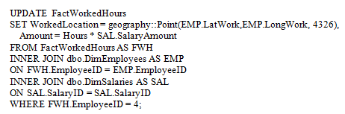
Sql server test scripts

Slide 7
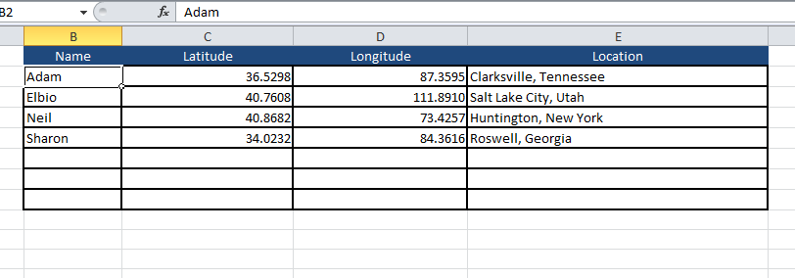
Sql server test scripts results

Slide 8
conclusion
The spatial PayRoll database allows office workers from Payroll enter the employees ‘ worked hours for the two weeks period. The database is simple with a few columns and the tables arranged in a star schema which makes a quick access to the information.

